Slide 1
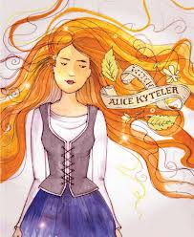
Witch of Kilkenny Dame Alice Kyteler 1280 - 1324
Leah and David Bracken

Slide 2
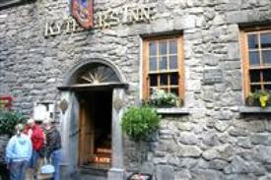
Early Life
Alice was born into a noble Kilkenny family in 1280. She was born in Kytelers House in Kilkenny. Her father was a banker and Alice inherited his business and home when he died in 1298. She married four times and each husband died mysteriously. She had two children, a boy and a girl. They had different fathers.
She was a very good looking rich woman and built Kytler’s Inn in Kilkenny.

Slide 3
What happens next.....?
On the death of her last husband Sir John le Poer, Alice’s children accused her of using poison and sorcery (magic) to kill them. They brought their case to the Bishop of Ossory, Richard de Ledrede in 1324. They hoped that their mother Alice would be arrested and they would get her fortune. Bishop de Ledrede investigated their claims by visiting Alice and talking with her children.

Slide 4
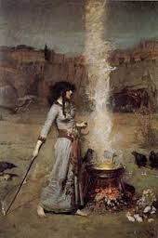
What did the Bishop find out?
According to the Bishop, Alice and her people (friends) didn’t believe in Christian faith. The Bishop said that Alice and her followers were making potions and killing animals for sacrifice to demons. It was very bad not to follow the Catholic religion. The punishment was death.....

Slide 5
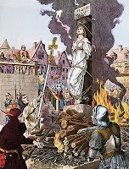
Alice’s Trial
The facts of her case are a little hard to find because it was so long ago.
There are many different versions of the "facts.“
You might expect this from a story that was based upon small-town gossip and scandal 700 years ago!!
People believed stories and rumour. Alice was wealthy and wicked!
The people of Kilkenny were maybe jealous and afraid of Alice and her followers

Slide 6
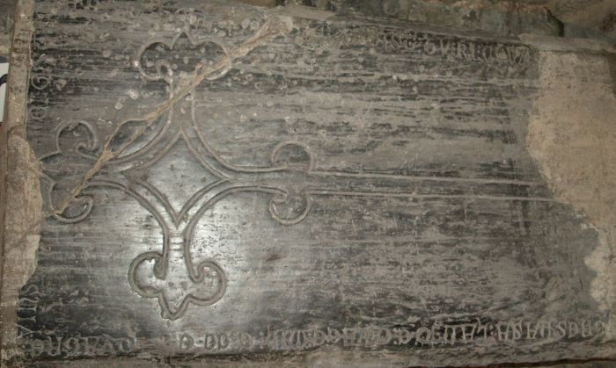
What Happened??
The Bishop de Ledrede wrote to the Chancellor of Ireland Roger Outlawe to have Alice put in jail
But he was her brother-in-law and did not put her in jail and put the Bishop in jail instead for 17 days
He got out and continued to try get Alice in jail.
Alice, her son William and 10 others were found guilty.
They were to be whipped, dragged by a horse and cart and burned at the stake.

Slide 7
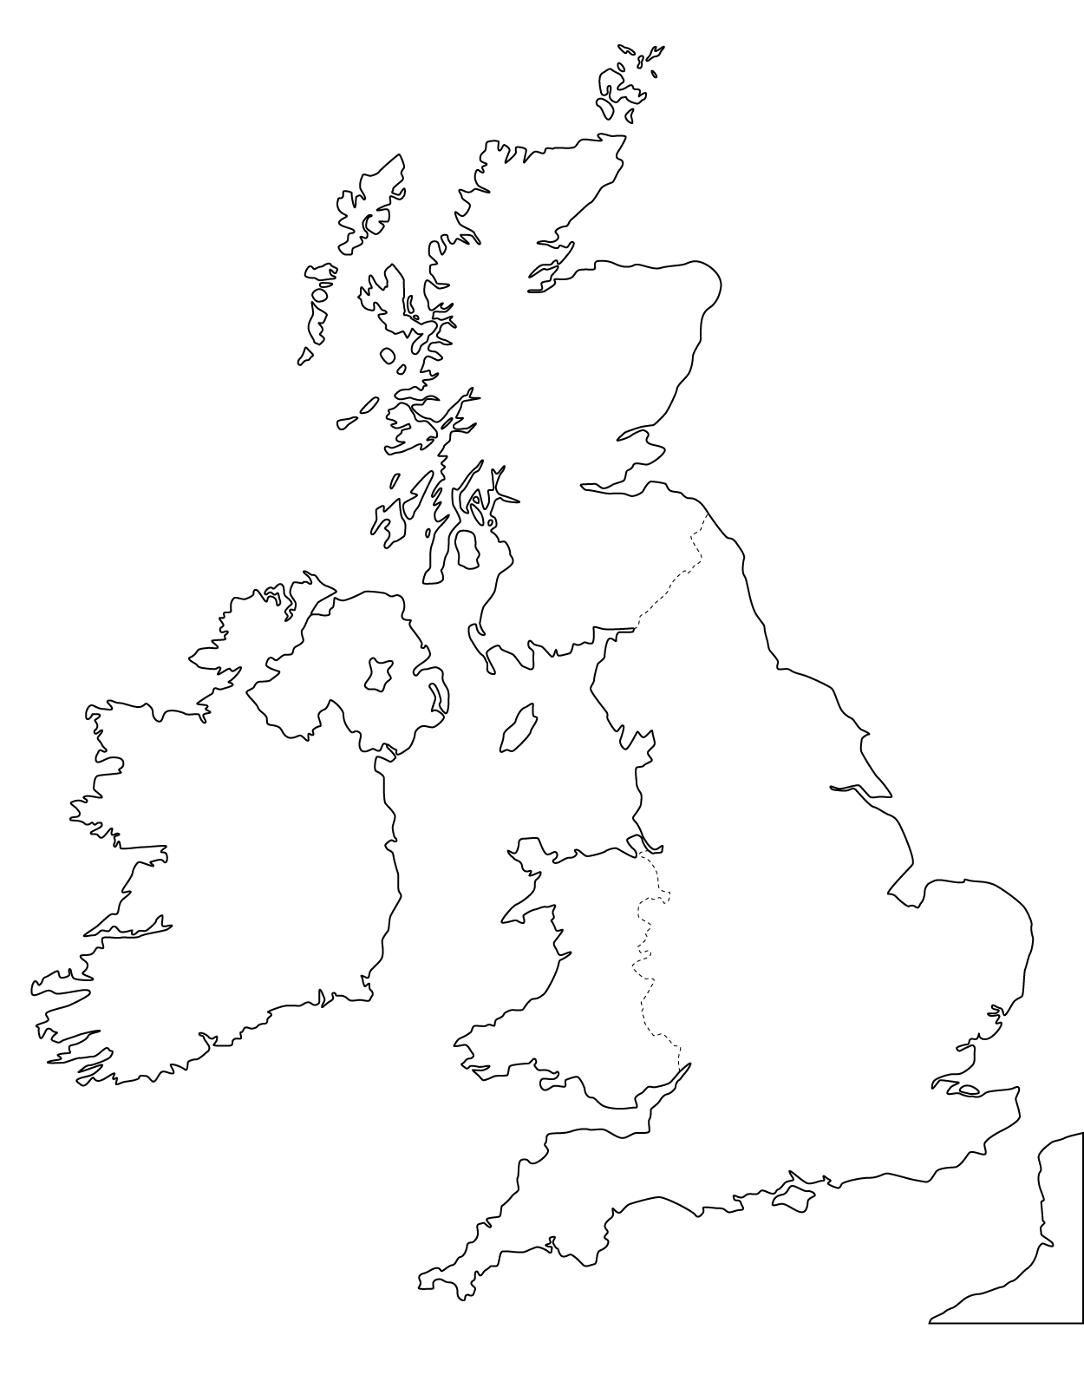
Final Events
Alice fled to England when she heard she was to be killed
Some say she lived to be an old woman.
Petronella -Alice’s maid was then accused of heresy.
She was tortured and then burned at the stake as all the Kilkenny people were waiting for a burning.
She was the first Irish person burned at the stake for being a witch!

Slide 8
Questions???
What year was she born?
How many times was Alice married?
What was the name of her maid?
What was Alice accused of?
Did they ever find Alice?
What did Alice build that we can still see in Kilkenny today??

