Slide 1
The Aran Islands
Charlie Delahunty

Slide 2
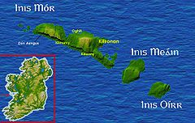
Facts
There are three Aran Islands , Inismór ,Inis Meáin and Inis Oirr.
They are found off the coast of Galway.
The population is 1,200.
The land is mainly limestone.

Slide 3
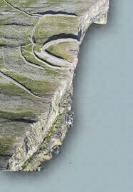
Inis Mór
It is the largest of the Aran Islands.
It has a famous site called Dùn Aengus.
It is an ancient fort on a cliff top.It has an area of 31 square kilometres.

Slide 4
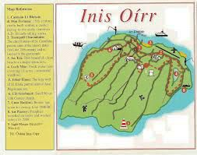
Inis Oírr
Inis Oírr is the most eastern of the Aran Islands. It is also the smallest of the three islands. The island has a very mild climate.
May is very sunny and a good time to see the famous wild flowers such as the orchids.

Slide 5
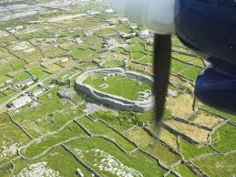
Inis Meáin
Inis Meàin is the middle
island. 160 people live there.
It also has an airstrip for planes to land.
There are two stone forts on the island Dùn Chonchùir and Dùn Fearbhaì.

Slide 6
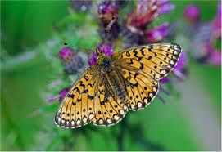
Flora and Fauna
Flora and fauna means the plants and wildlife.
Mediterranean flowers grow there.
The insects on the island are butterflies,moths and hoverflies.

Slide 7
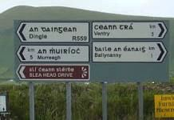
Irish language
The Aran islands is a Gaeltacht,this means they speak irish all the time.
This is probably due to their isolation from the mainland.

Slide 8
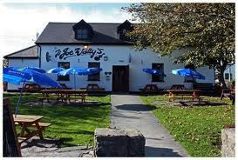
Tourism
There are a lot of attractions on the island, so tourism is very popular here. They come to visit Dún Aengus ,Black fort and O'Briens castle. Teampull Bheanàin is the smallest church in the world and is also visited by many.

Slide 9
The End
Thanks for watching.

